Slide 1
Weakly supervised object localization
Thesis midterm – 15/2/2023
Geert Goemaere

Slide 2
Content
Introduction
Research question
Method
Experiments
Next steps

Slide 3
Introduction

Slide 4

Object recognition tasks and multi-instance WSOL
WSOL
Multiple-instance WSOL
Notes:
The research topic of this thesis is called “multiple-instance weakly supervised object localization” (multiple-instance WSOL).
So, let’s first explain where in the object recognition landscape whe can situate multi-instance WSOL by looking at different tasks in this picture.
Image classification deals with assigning a single label or category) to an image. Here the label is CAT.
Object localization deals with localizing objects in an image by indicating their bounding box. In the case of WSOL, only a single object is localized by training a model with class labels only.
Object detection is the task of locating objects in an image with bounding boxes and assigning a class label for each detection.
Instance segmentation deals with assigning a class label for each pixel of an image.
Just as WSOL, multi-instance WSOL uses only class labels to train a model for localization, but it extends WSOL to find mutiple objects of the same class.

Slide 5
Why WSOL?
Problem
Object detection achieves great performance, but …
Requires costly human labelling of bounding boxes
Localization labels not always available or of poor quality
Solution
Weakly supervised: Only image-level labels are used to train model
Object localization based on learned features

Slide 6
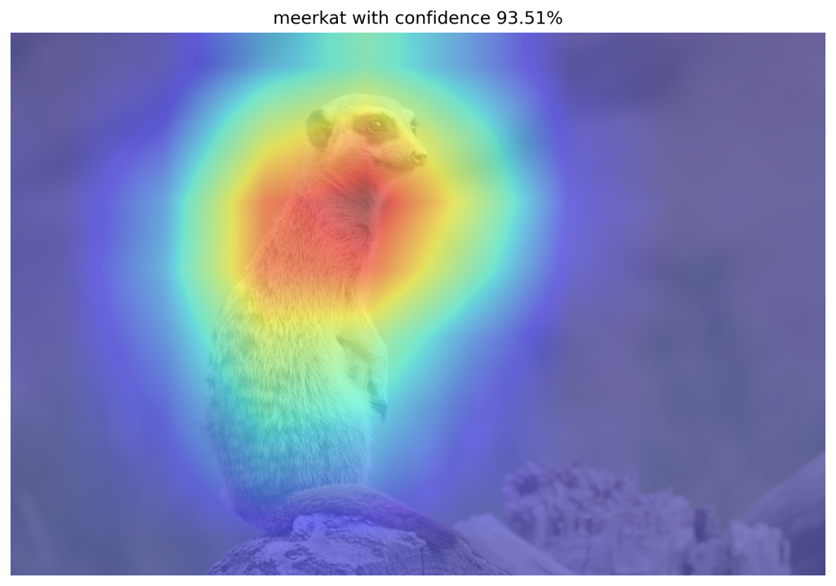
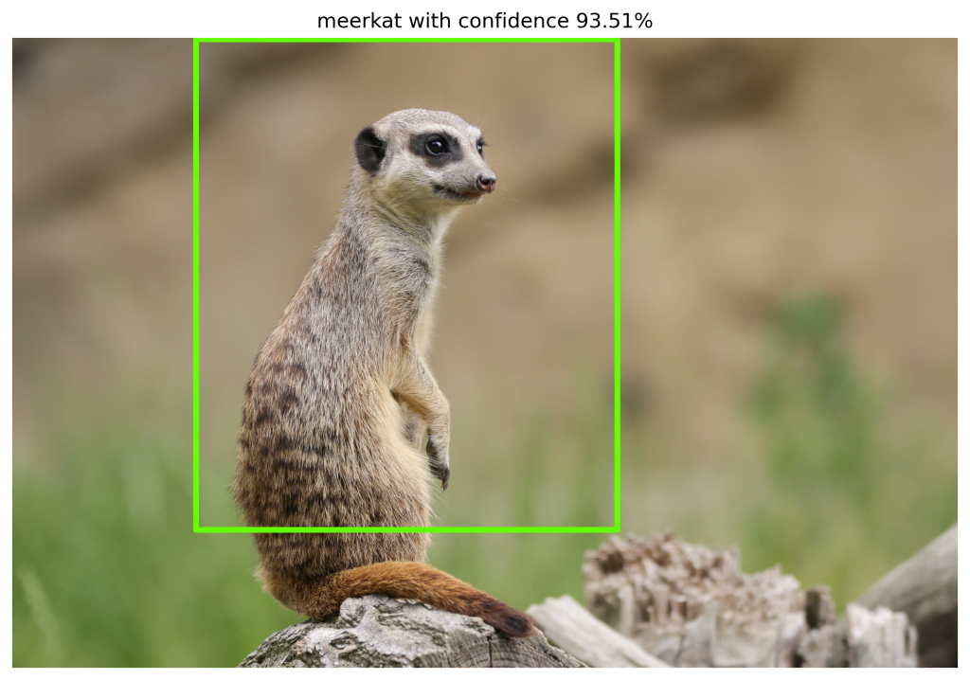
WSOL prior-art (deep learning)
Class Activation Mapping (CAM)
Baseline method
Feature activations used to localize objects
Limitations
Focus on most discriminative parts of object
Partial object localization
CAM research
Use other techniques to overcome limitations
E.g. MinMaxCAM, GradCAM, ScoreCAM

Slide 7
Problems of WSOL
Assumption of single object class in image
Multi-instance localization hasn’t been tested so far
Interesting to evaluate multi-instance WSOL
Requires revising of evaluation metrics

Slide 8
Research question
Can we use WSOL CAM-methods to localize multiple instances of the same class?
This research
Define valuation metrics for multi-instance WSOL
Benchmark multi-instance localization on specific CAM methods
Investigate improvements for multi-instance WSOL

Slide 9
Method
Multiple-instance WSOL

Slide 10
Localization based on CAM methods
CAM
Baseline
GradCAM
Generalized CAM
ScoreCAM
Promising for multi-instance localization
MinMaxCAM
Object coverage regularization

Slide 11
Networks
VGG16 and ResNet50
Used in most papers
VGG16-GAP variant
Required for CAM, MinMaxCAM
Added GAP-layer + FC-layers replaced with softmax layer

Slide 12
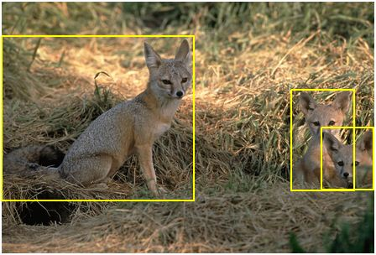
Datasets
SYNTHETIC
ImageNet-1k
9 classes
4 datasets: fixed instance count (1..4)
Ground truth: Class labels, bounding boxes, segmentation masks
1000 classes, natural images
Validation set used for testing (common approach)
Ground truth: Class labels, bounding boxes

Slide 13
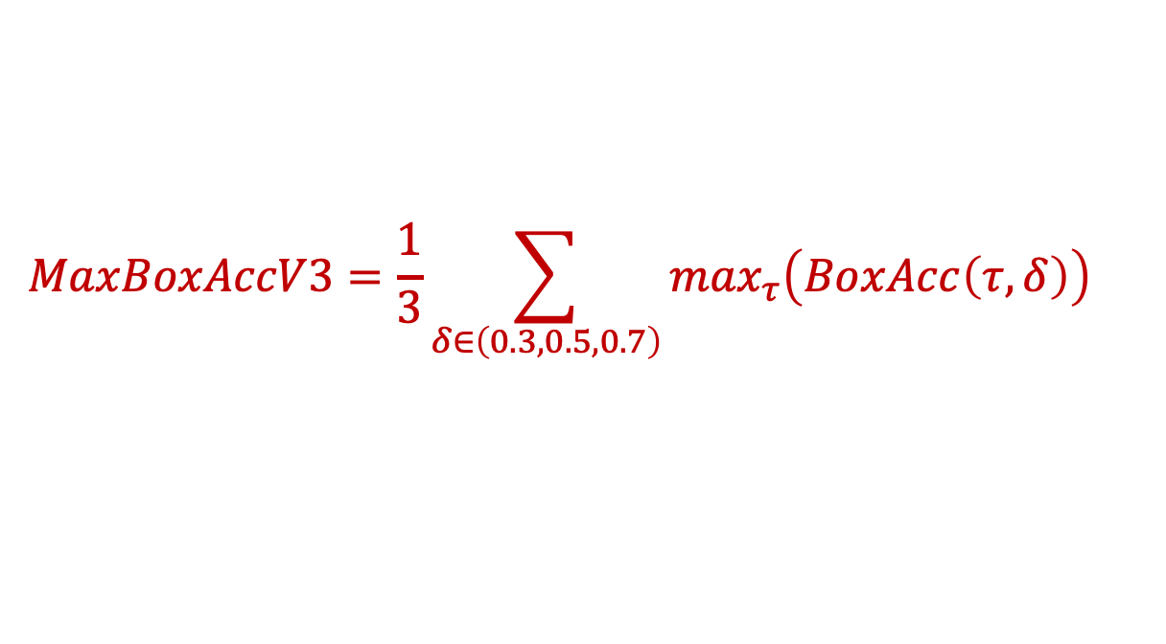
Metrics – MaxBoxAccV3
Reference: MaxBoxAccV2 [Choe et al., 2020b]
Considers single best match between GT and estimated bounding boxes
MaxBoxAccV3 modifies V2:
For each GT bounding box, consider best match with estimated bounding boxes
$$MaxBoxAccV3=\frac{1}{3}\sum_{δ∈\left(0.3,0.5,0.7\right)}{\max_{τ}\left(BoxAcc\left(τ,δ\right)\right)}$$

Slide 14
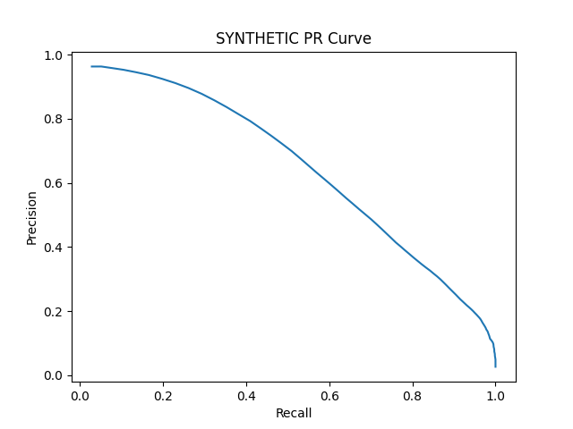
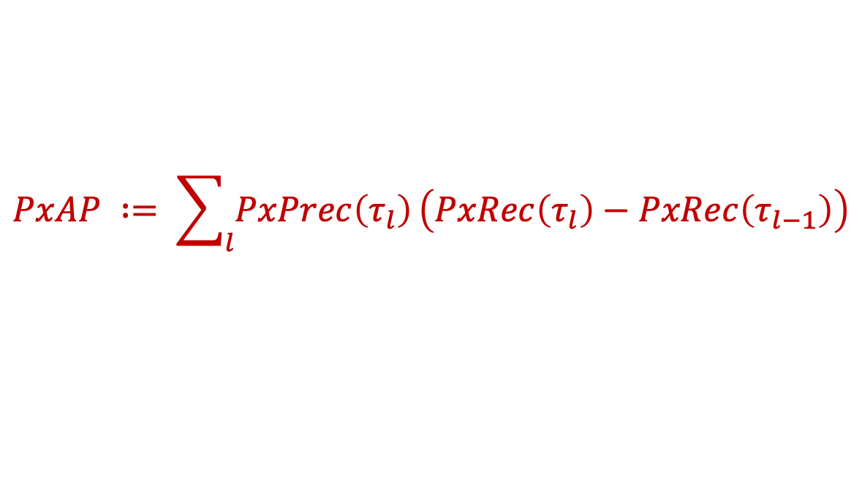
Metrics – Pixel Average Precision (PxAP)
PxAP already used in [Choe et al., 2020b]
Applies to multi-instance localization
Only usable when GT segmentation masks available
$$PxAP ∶= \sum_{l}{PxPrec\left(τ_{l}\right)}\left(PxRec\left(τ_{l}\right)−PxRec\left(τ_{l−1}\right)\right)$$

Slide 15
Experiments

Slide 16
Localization performance – MaxBoxAccV3
 | VGG16-GAP (SYNTHETIC object instances) |  |  |  | VGG16 (SYNTHETIC object instances)
Method | 1 | 2 | 3 | 4 | 1 | 2 | 3 | 4
CAM | 86.83 | 45.58 | 41.50 | 15.71 | - | - | - | -
GradCAM | 86.83 | 45.58 | 41.50 | 15.71 | 74.50 | 32.08 | 30.17 | 9.17
ScoreCAM | 91.83 | 60.08 | 56.28 | 26.50 | 70.50 | 43.08 | 35.17 | 13.25
MinMaxCAM | 87.17 | 48.92 | 45.99 | 16.00 | - | - | - | -
Notes:
VGG16:
All methods
Good at single-instance
Drops significantly for 2/3 instances
Bad for 4 instances
ScoreCAM
has best MaxBoxAccV3 performance (bar VGG16 single instance)
big difference with others: 5-15 percentage points
Concurs with paper conclusions that ScoreCAM is better in localizing multiple instances
VGG16-GAP versus VGG16
VGG16-GAP significantly better performance
VGG16 has no GAP layer annd 3 FC-layers which adds complexity (more learnable weights) and a less direct relationship between feature maps and classification score.

Slide 17
Localization performance – PxAP
 | VGG16-GAP (SYNTHETIC object instances) |  |  |  | VGG16 (SYNTHETIC object instances)
Method | 1 | 2 | 3 | 4 | 1 | 2 | 3 | 4
CAM | 86.87 | 63.46 | 58.40 | 29.04 | - | - | - | -
GradCAM | 86.87 | 63.46 | 58.40 | 29.04 | 67.99 | 39.15 | 41.93 | 13.05
ScoreCAM | 85.64 | 70.06 | 67.66 | 38.97 | 68.80 | 53.33 | 45.85 | 21.40
MinMaxCAM | 86.55 | 65.35 | 61.21 | 26.51 | - | - | - | -
Notes:
Similar picrture as for MaxBoxAccV3.
- ScoreCAM performs best by large margin for multiple instances.

Slide 18
Learning curves
Observations
Example: MinMaxCAM for VGG16-GAP SYNTHETIC
Classification training hurts localization performance
Bests localization after few training epochs
Drops when classification performance converges
More accurate classification may focus on most discriminative parts
In line with Choe et al, 2020b findings

Slide 19
Next steps

Slide 20
Next steps
CAM method benchmarking for ImageNet-1k dataset
Try possible improvement leads for multi-instance localization
Iterative bounding box extraction
Feed image to model and capture feature activation maps (CAMS)
Compute bounding boxes on binarized CAMs using operational threshold
Mask computed bounding boxes in image (e.g. with noise, zero values)
Repeat until some stop criterion (e.g. no bounding boxes found)
Variant: Mask image with binarized CAMs

Slide 21



Slide 22
Backup

Slide 23
Method

Slide 24
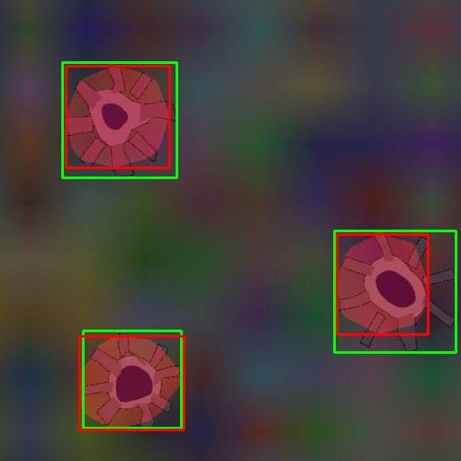
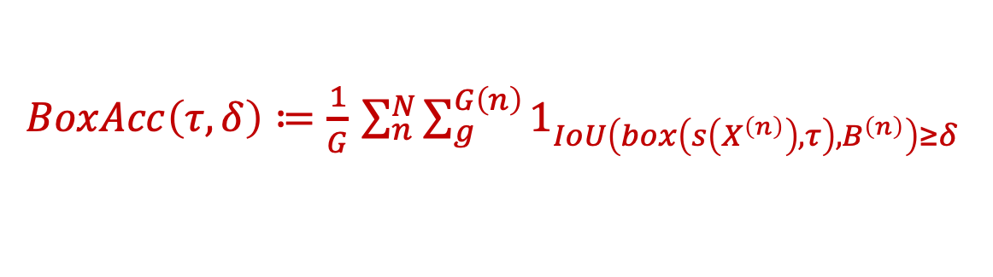
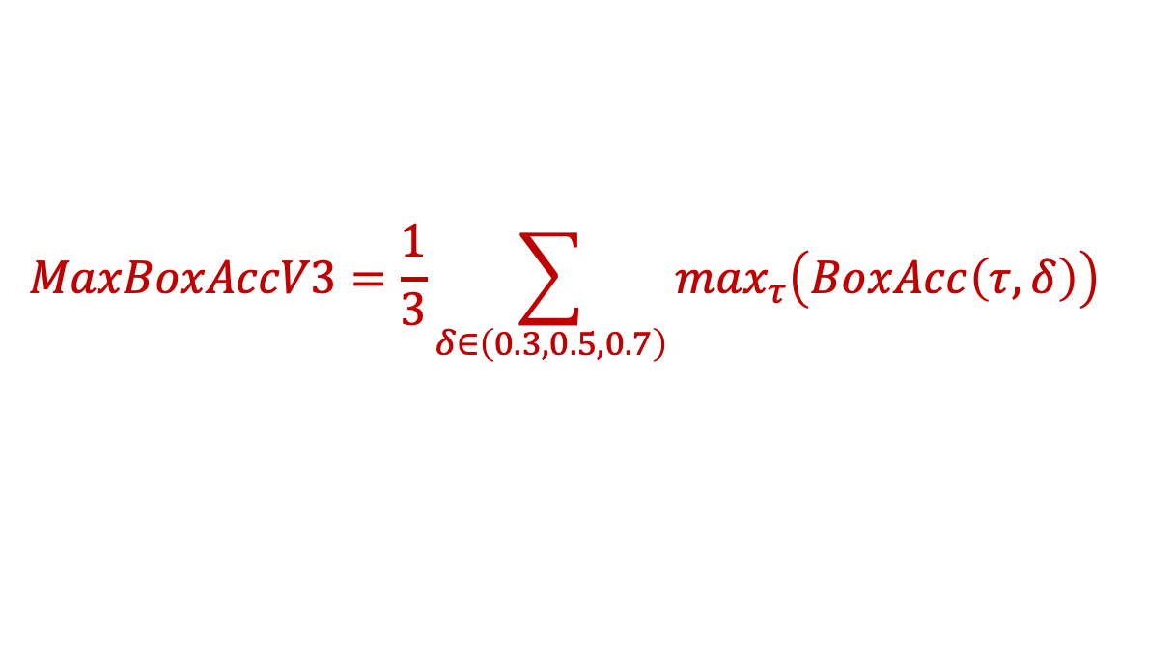
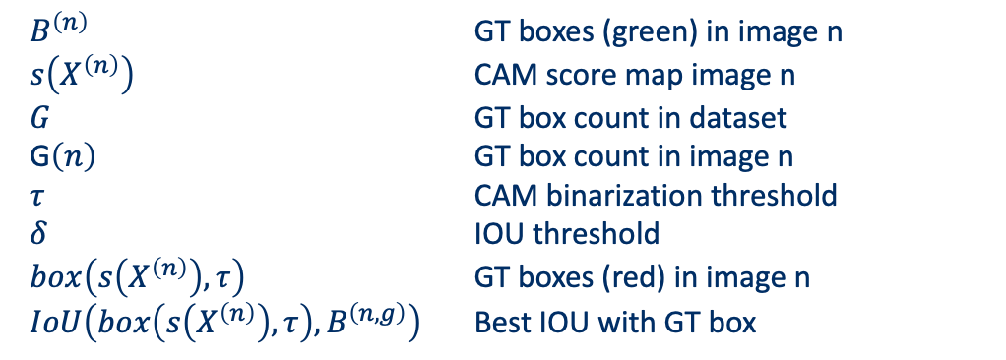
Metrics – MaxBoxAccV3
$$MaxBoxAccV3=\frac{1}{3}\sum_{δ∈\left(0.3,0.5,0.7\right)}{\max_{τ}\left(BoxAcc\left(τ,δ\right)\right)}$$
Choe et al, 2020b: MaxBoxAccV2 modified for multi-instance WSOL
$BoxAcc\left(τ,δ\right)≔\frac{1}{G}$ $\sum_{n}^{N}{\sum_{g}^{G\left(n\right)}{1_{IoU\left(box\left(s\left(X^{\left(n\right)}\right),τ\right),B^{\left(n\right)}\right)≥δ}}}$
$B^{\left(n\right)}$ GT boxes (green) in image n
$s\left(X^{\left(n\right)}\right)$ CAM score map image n
$G$ GT box count in dataset
G$\left(n\right)$ GT box count in image n
$τ$ CAM binarization threshold
$δ$ IOU threshold
$box\left(s\left(X^{\left(n\right)}\right),τ\right)$ GT boxes (red) in image n
$IoU\left(box\left(s\left(X^{\left(n\right)}\right),τ\right),B^{\left(n,g\right)}\right)$ Best IOU with GT box

Slide 25

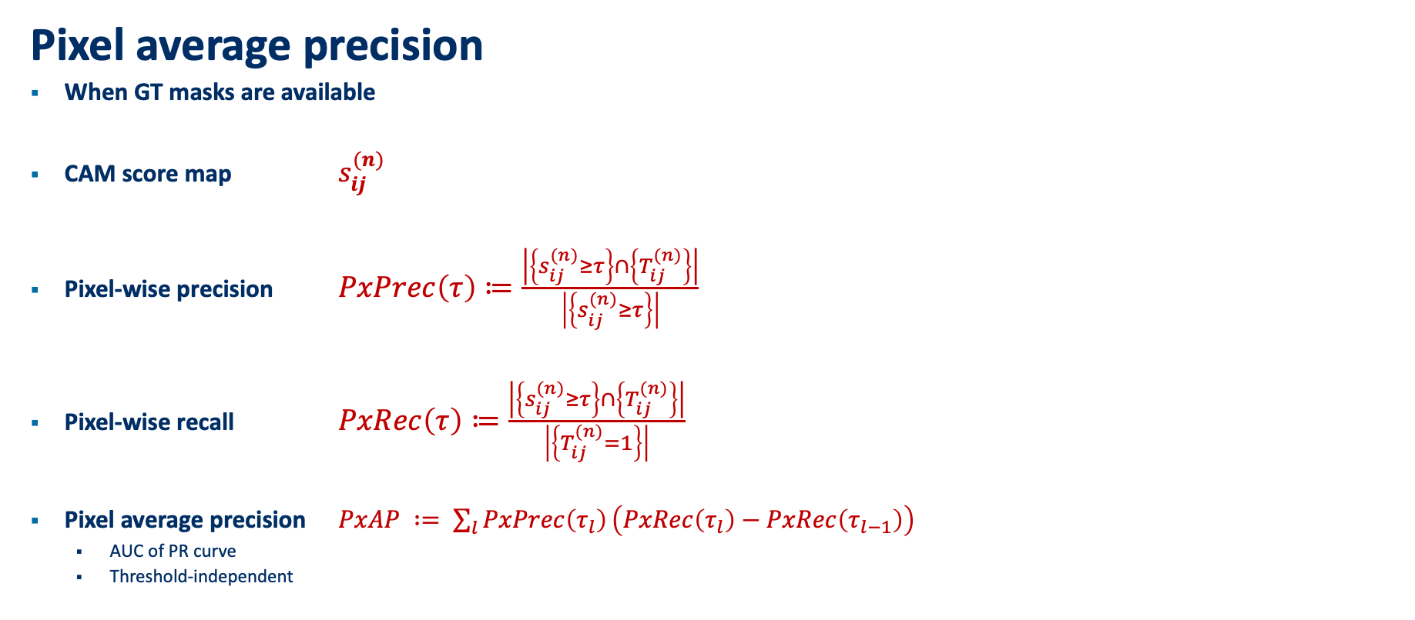
Multiple-instance WSOL - Metrics
Pixel average precision
When GT masks are available
CAM score map $s_{ij}^{(n)}$
Pixel-wise precision $PxPrec\left(τ\right)≔\frac{\left|\left\{s_{ij}^{(n)}≥τ\right\}\right.∩\left.\left\{T_{ij}^{(n)}\right\}\right|}{\left|\left\{s_{ij}^{(n)}≥τ\right\}\right|}$
Pixel-wise recall $PxRec\left(τ\right)≔\frac{\left|\left\{s_{ij}^{(n)}≥τ\right\}\right.∩\left.\left\{T_{ij}^{(n)}\right\}\right|}{\left|\left\{T_{ij}^{(n)}=1\right\}\right|}$
Pixel average precision $PxAP ∶= \sum_{l}{PxPrec\left(τ_{l}\right)}\left(PxRec\left(τ_{l}\right)−PxRec\left(τ_{l−1}\right)\right)$
AUC of PR curve
Threshold-independent

Slide 26
Experiments

Slide 27
Box Accuracy at varying CAM thresholds (IOU 50)
Notes:
BoxAcc for 1, 2, 3, 4 instance datasets
1 instance: All CAM methods perform similarly, outperformed by ScoreCAM
2,3,4: ScoreCAM performance margin over others even more pronounced
Optimal CAM threshold similar for all methods

Slide 28
Precision-Recall at varying CAM thresholds
Notes:
PR-Curves at varying CAM thresholds:
Allows us to choose preferred operating thresholds that provides the best precision-recall trade-off
1 instance: similar performance for all methods
2,3,4 instance:
ScoreCAM outperforms rest
AUC drops significantly

Slide 29
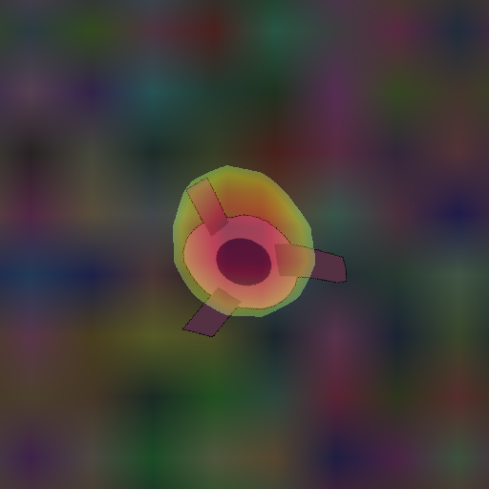
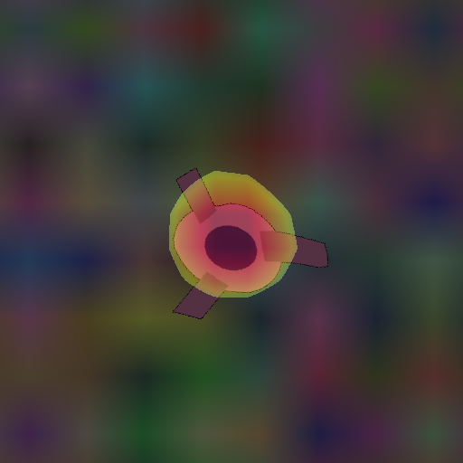
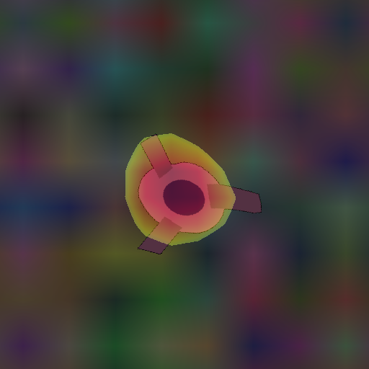
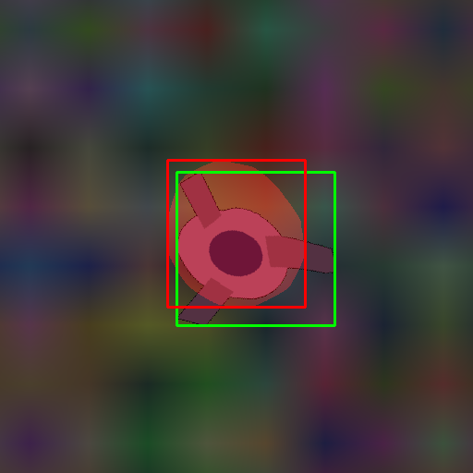
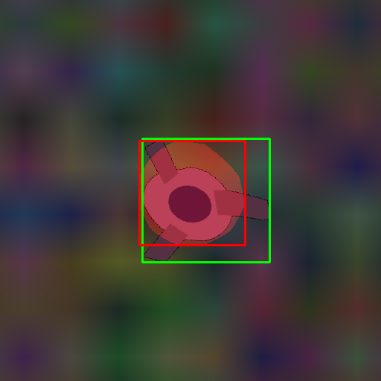
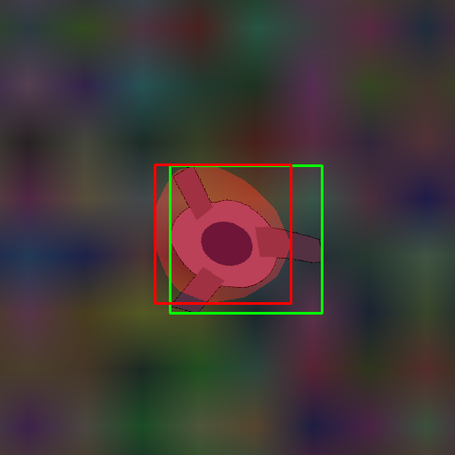
Qualitative analysis: SYNTHETIC – 1 instance
CAM (test119)
MinMaxCAM
ScoreCAM
Notes:
Single instance performance seems similar for all CAM methods
MinMaxCAM: slightly worse. May not be regularized enough.

Slide 30
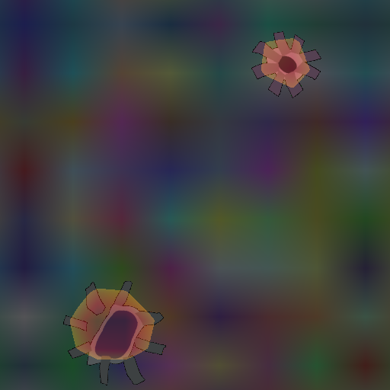
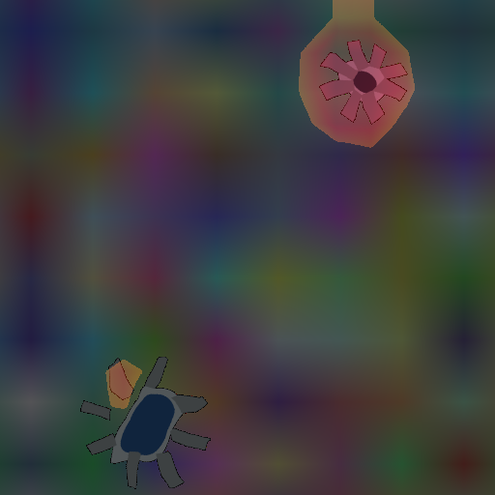
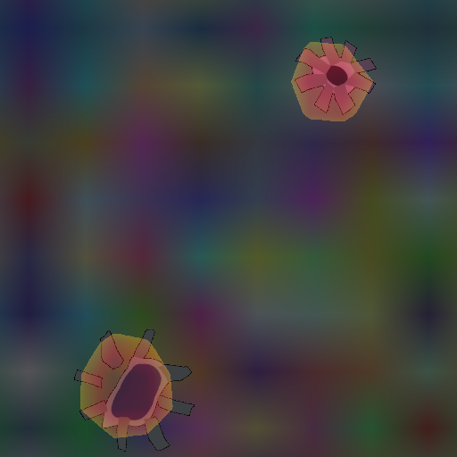
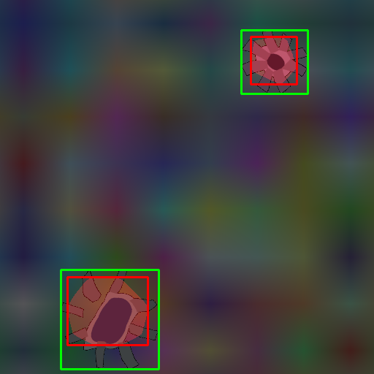
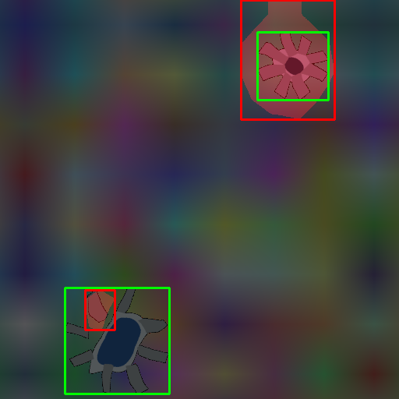
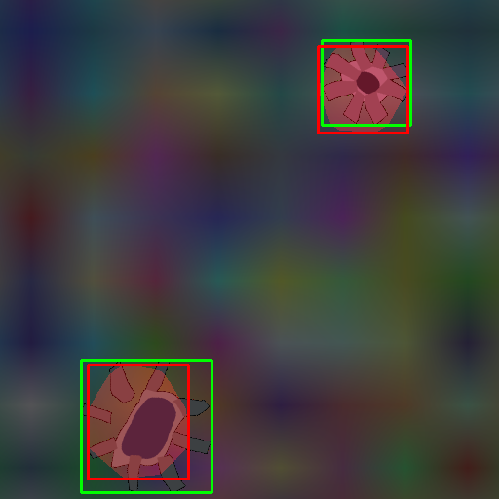
Qualitative analysis: SYNTHETIC – 2 instances
CAM (test102)
MinMaxCAM
ScoreCAM
Notes:
CAM focus on most discriminative features and underfits instances
MinMaxCAM: Overfitting 1 instance, partly fitting other instance
ScoreCAM more accurately loalizes multiple instances
A score-weighted combination of feature maps instead of a global average weighted one, seems better to solve the problem of identifying mutiple occurrences of the same class in an image..

Slide 31
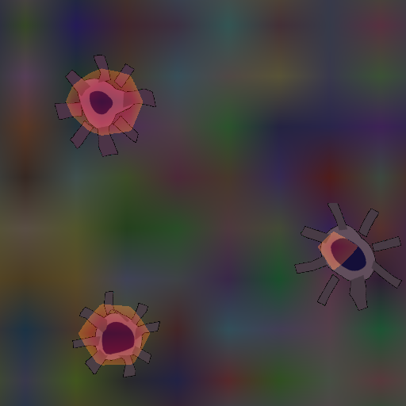
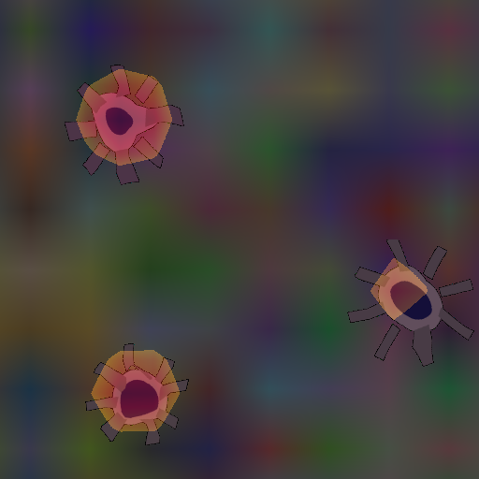
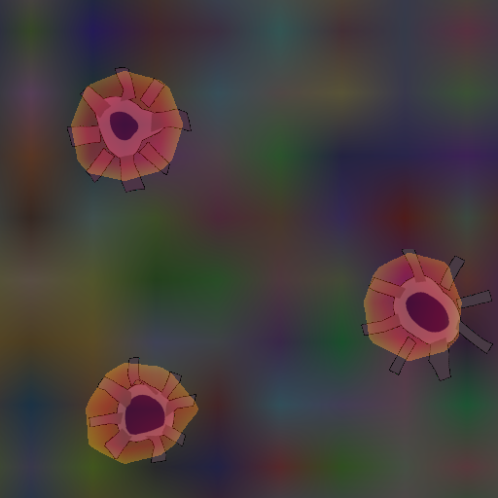
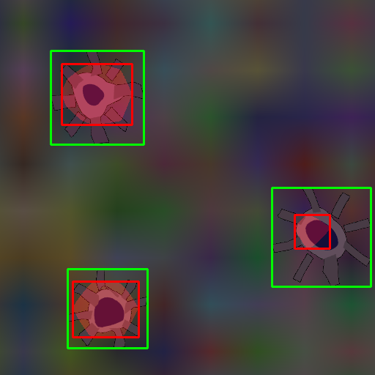
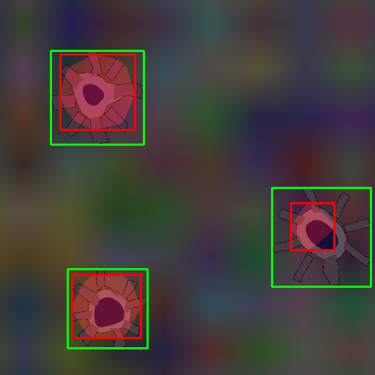
Qualitative analysis: SYNTHETIC – 3 instances
CAM (test103)
MinMaxCAM
ScoreCAM
Notes:
Same conclusions as for 2 instances.

Slide 32
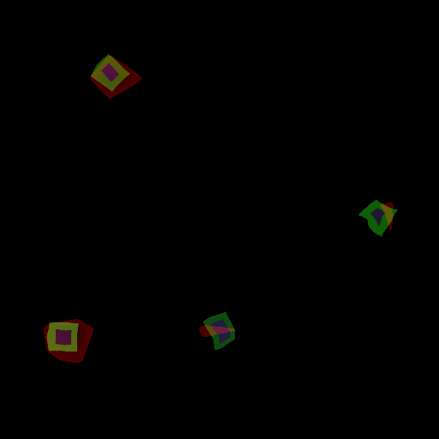
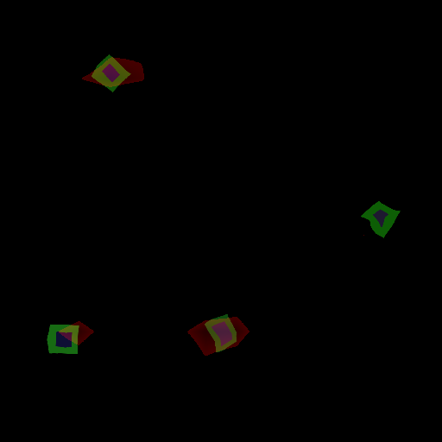
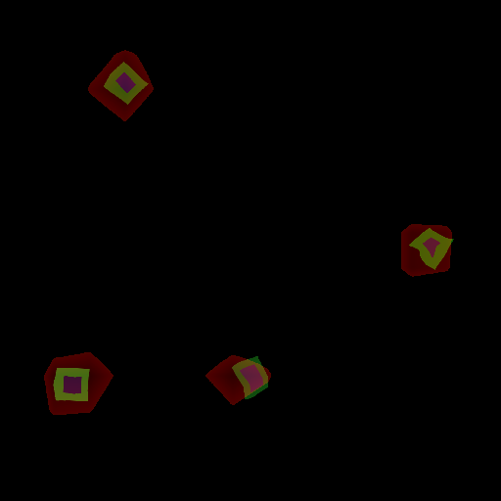
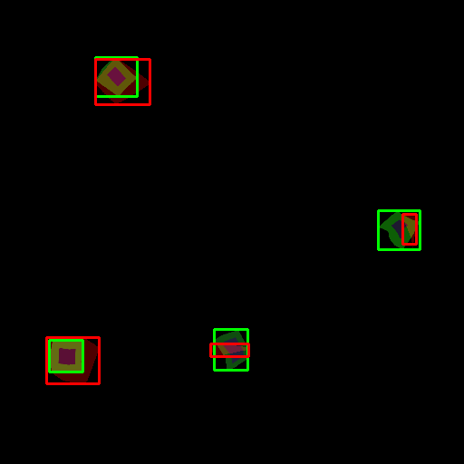
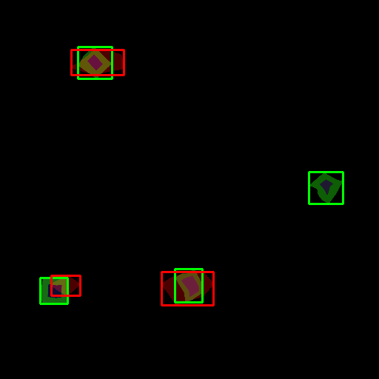
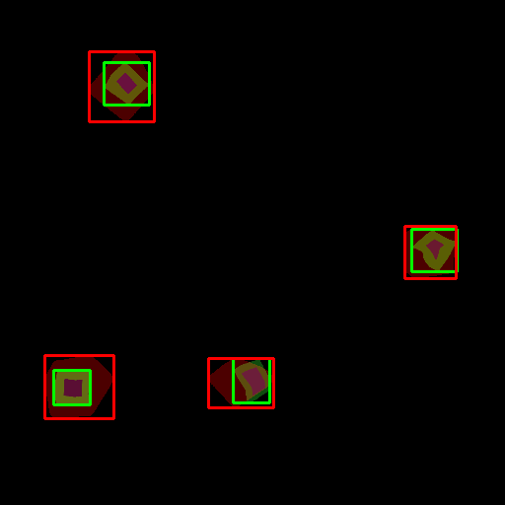
Qualitative analysis: SYNTHETIC – 4 instances
CAM (test130)
MinMaxCAM
ScoreCAM
Notes:
Smaller object instances are more challenging to localize. Easier to miss.
This example shows better-than-average performance
MinMaxCAM: more regularization may be needed
ScoreCAM: again better at capturing instances

Slide 33
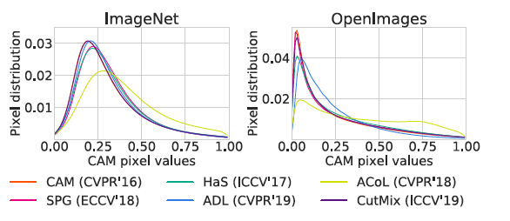
CAM pixel value distributions
Example from Choe et al., 2020b
CAM pixel value distributions (E.g. figure 13 in WSOL evaluation paper)

Slide 34
Cumulative distribution function (CDF)
To be investigated if useful
CDF of what?
Pixel values? (same as pixel distribution slide)

Slide 35
Next steps

Slide 36
Multiple-instance WSOL - Improvements
Challenge
1 operational threshold to extract bounding boxes
Not all object instances of similar intensity
Proposal: Iterative bounding box extraction
Process
Image is fed to model and CAM score map is computed
Bounding boxes are extracted using operational CAM threshold.
Bounding boxes are masked (deleted, greyed, noise-filled) in image
Operational CAM threshold is lowered. Repeat 1 if no stop criteria is met.
Possible stop criteria:
No new bounding boxes are found
Predefined minimum CAM threshold is reached
Predefined drop in classification score is reached
Predefined number of iterations is reached.

